Slide 1
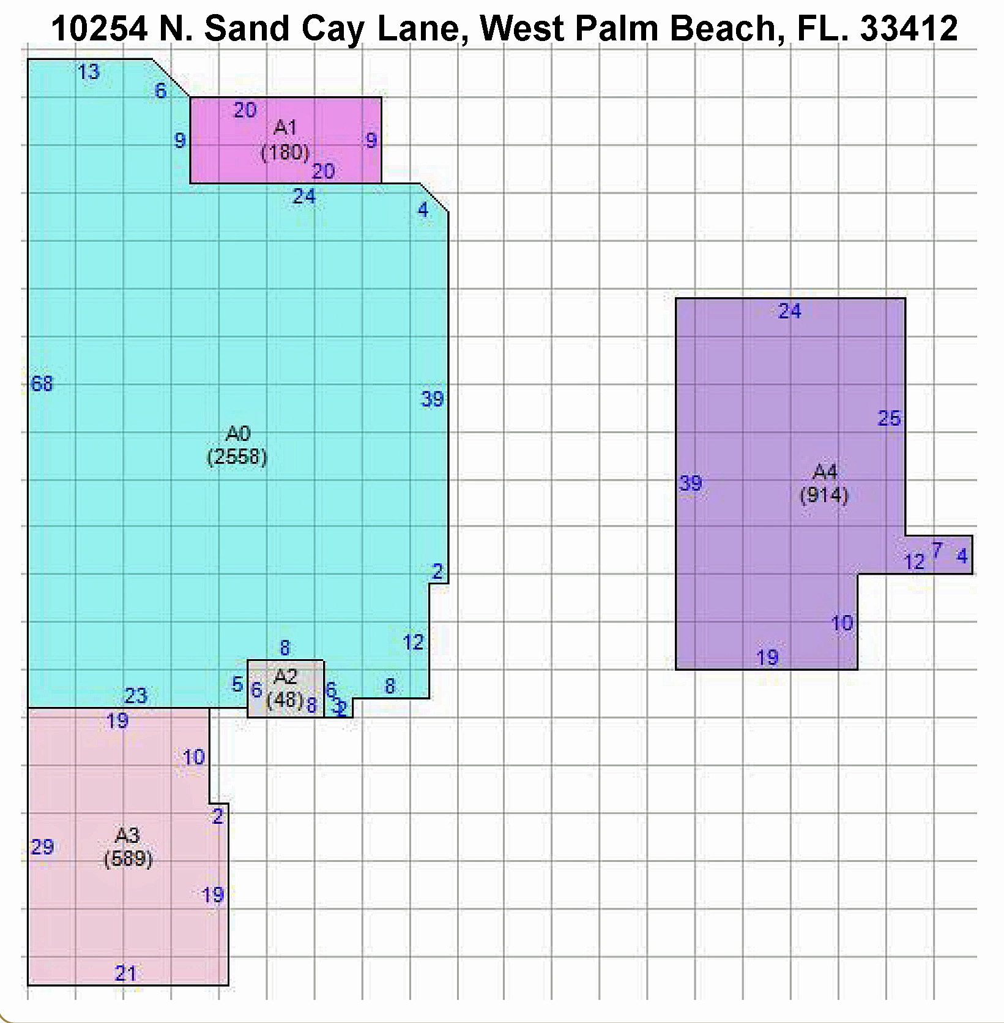
Rocco A. Quaglia, PA
ACP, CIPS, PPMC, Realtor
Sr. Fine Homes & Estate Specialist
Cell/Text: (561) 235-8212
Email: RoccoRealtor@att.net
Website: www.FloridaFineHomesAndEstates.com
Regency Realty Services
861 Yamato Road, Suite 5
Boca Raton, FL. 33431
Basic Floor Plan
All Information Contained Herein Has Been Obtained From Sources Deemed Reliable. Although We Have No Reason To Doubt
Its Accuracy, We Regret We Cannot Guarantee It. All Properties Are Subject To Change Or Withdrawal Without Notice.
Please Contact Rocco A. Quaglia, PA, ACP, CIPS, PPMC, Realtor For Any Questions At (561) 235-8212.

Slide 2
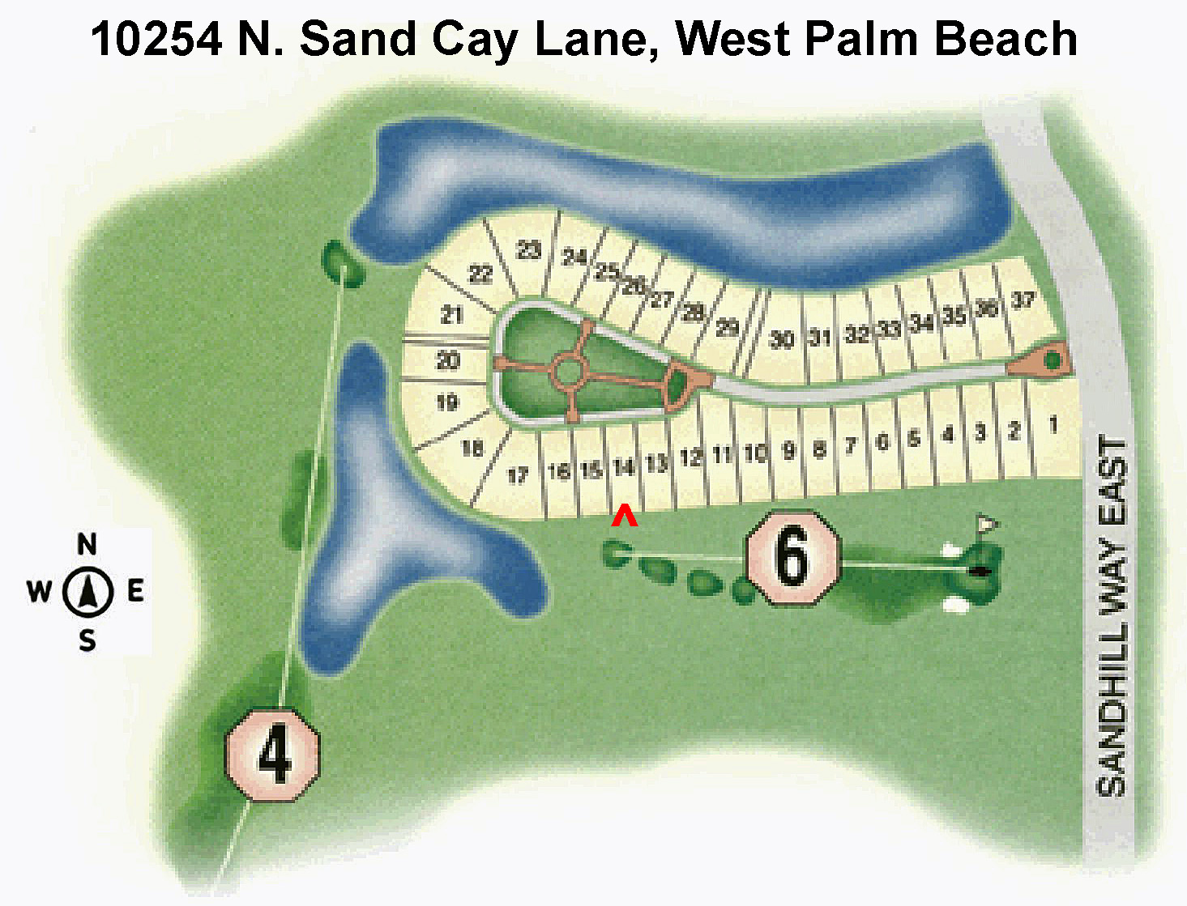
Rocco A. Quaglia, PA
ACP, CIPS, PPMC, Realtor
Sr. Fine Homes & Estate Specialist
Cell/Text: (561) 235-8212
Email: RoccoRealtor@att.net
Website: www.FloridaFineHomesAndEstates.com
Regency Realty Services
861 Yamato Road, Suite 5
Boca Raton, FL. 33431
Lot Map
All Information Contained Herein Has Been Obtained From Sources Deemed Reliable. Although We Have No Reason To Doubt
Its Accuracy, We Regret We Cannot Guarantee It. All Properties Are Subject To Change Or Withdrawal Without Notice.
Please Contact Rocco A. Quaglia, PA, ACP, CIPS, PPMC, Realtor For Any Questions At (561) 235-8212.

